Slide 1
Chapter 6 Part 2 6.4 - 6.9
By Jordan Donovan

Slide 2
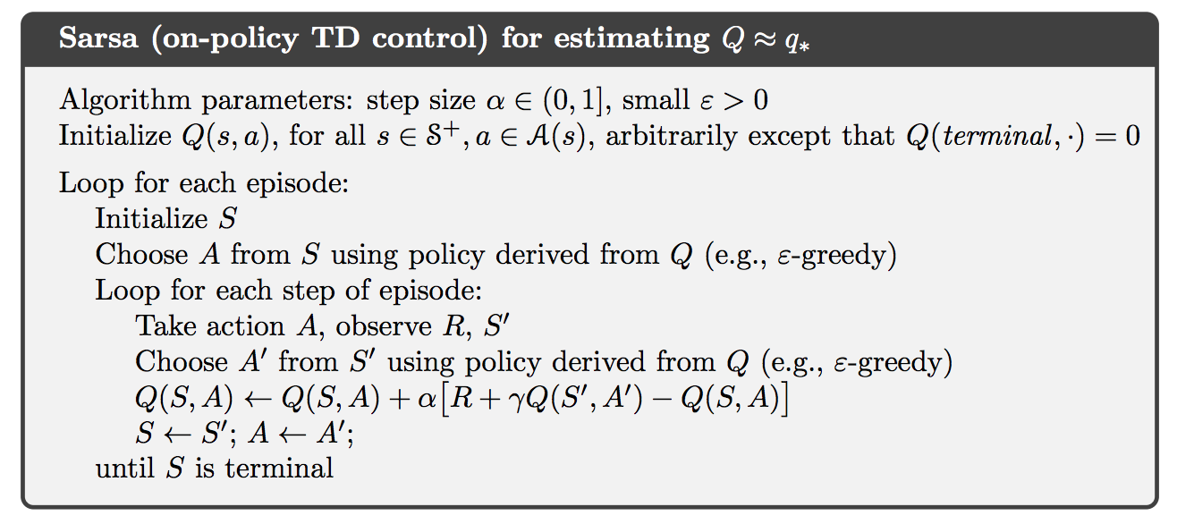
Sarsa: On-Policy TD Control
Learn action-value function
Transition from state-action pair to the next involves quintuple: (St, At, Rt+1, St+1, At+1)
Notes:
Learn action-value function
Continually Estimate qπ for the current behavior policy π and for all states s and actions a
qπ(s, a) value of taking action a in state s under policy π
Instead of state-value function
Theorems for assuring state values converge also apply to corresponding action values
Sarsa’s convergence properties depend on the policies’ dependence on Q
Convergence is guaranteed as long as all state-action pairs are visited an infinite number of times and the policy converges in the limit to the greedy policy
Note: Q, Qt array estimates of action-value function qπ or q∗

Slide 3
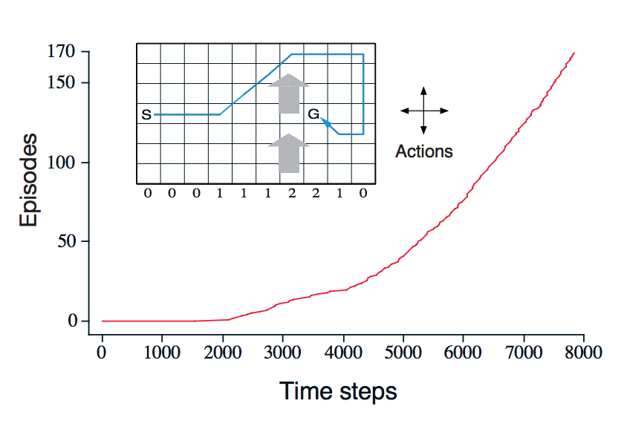
SARSA Example
Monte Carlo cannot be used easily
Notes:
Monte Carlo methods cannot be used easily since they update at the end of an episode, and termination is not guaranteed for all policies.
If a policy was found that made the agent stay in the same state / place, then the episode would never end.
Step-by-step learning methods such as Sarsa allow for the policies to be updated during an episode and do not have this problem.
Note: Q, Qt array estimates of action-value function qπ or q∗

Slide 4
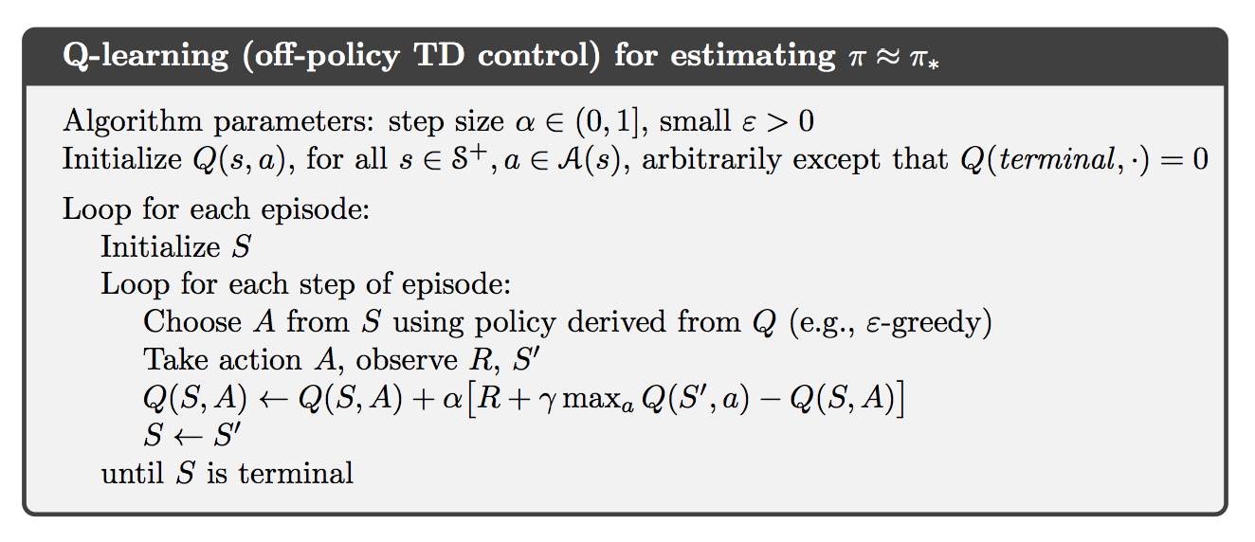
Q-Learning: Off-Policy TD Control
Learned action-value function directly approximates q*
Notes:
Learned action-value function directly approximates q* independent of policy being followed
q∗(s, a) value of taking action a in state s under the optimal policy
The policy still determines which state-action pairs are visited and updated
All that is required for convergence is that all pairs continue to be updated
Note: Q, Qt array estimates of action-value function qπ or q∗

Slide 5
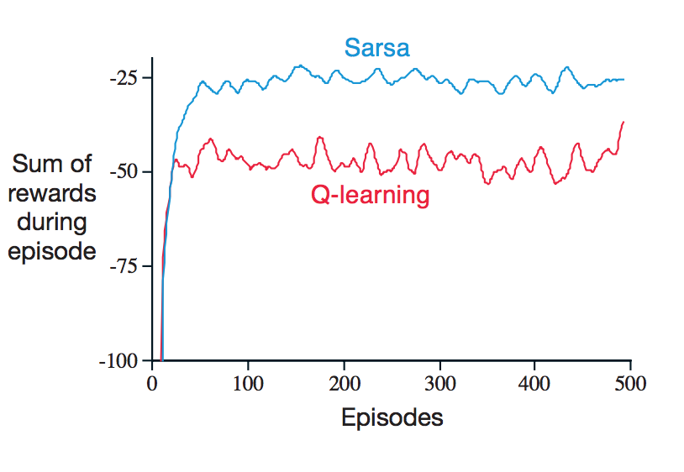
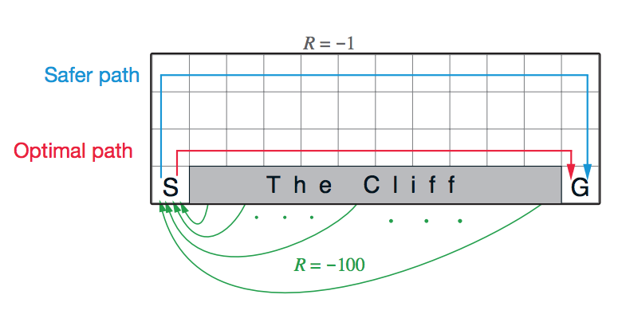
Example of Q-Learning versus Sarsa
Q-learning learns optimal policy along cliff’s edge
Sarsa takes action selection into account and learns safer path
Notes:
Q-learning occasionally falls off of cliff due to action selection
If epsilon was gradually reduced, both would asymptotically converge to optimal policy

Slide 6
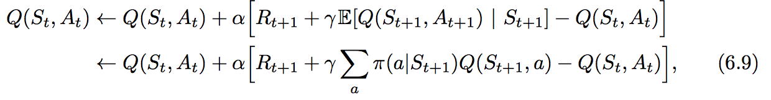
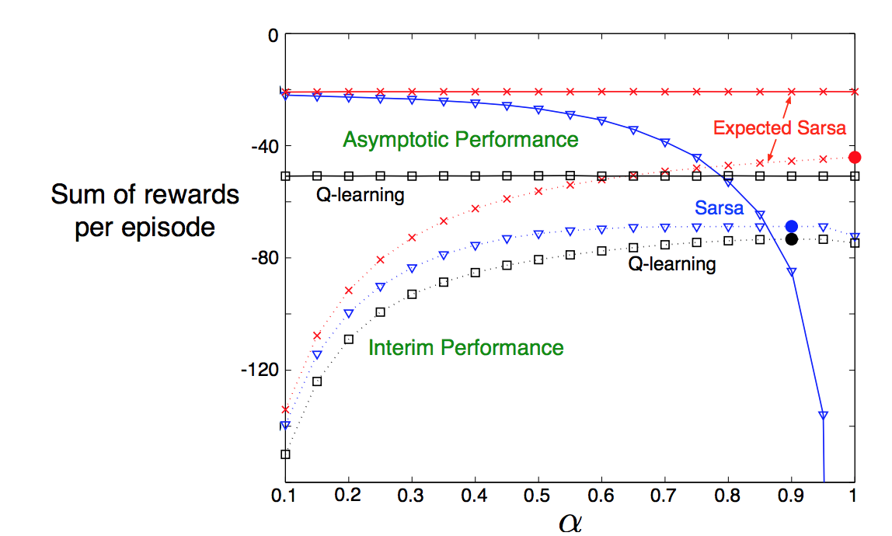
Expected Sarsa
Q-learning algorithm except it takes into account how likely each action is under the current policy
Deterministic movement leads to improvement on Sarsa
Notes:
Deterministically moves in the same direction as Sarsa
More complex than Sarsa, but it removes the variance of the random selection At+1
State transitions are all deterministic, thus alpha does not matter asymptotically for Expected Sarsa
Expected Sarsa can be on- or off-policy

Slide 7
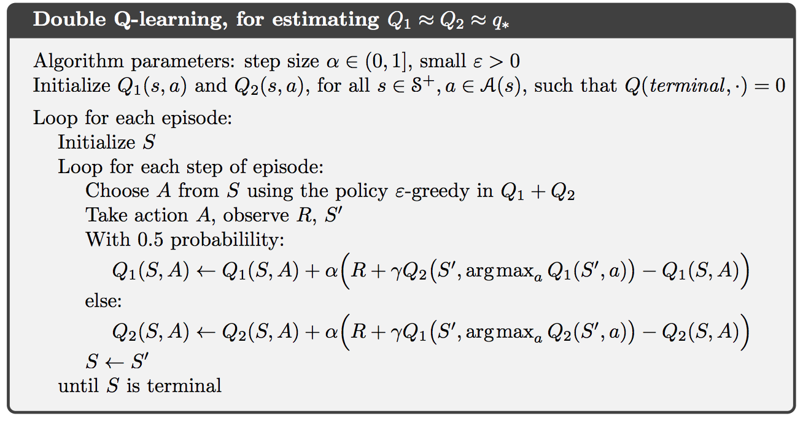
Maximum Bias and Double Learning
All of the control algorithms discussed involve maximization in the construction of their target policies.
Maximum estimates can be greater than all true values – maximization bias
We can use two unbiased estimates
Use one estimate to maximizing action, and the other to provide estimate of its value; then reverse for two unbiased estimates.
It then updates one of the estimates based on a coin flip.
An average can be used for the policy

Slide 8
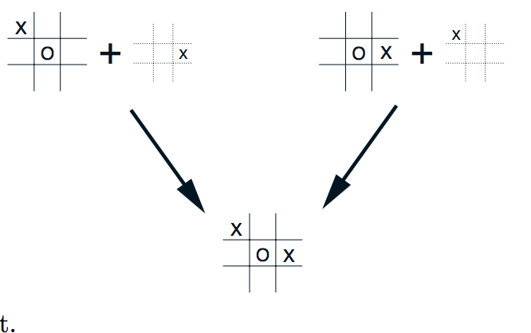
Games, Afterstates, and other Special Cases
Afterstates involve evaluation of state and actions after some unknowing change in environment
Afterstates apply to several problems
Other specialized problems can be considered with generalized policy iteration
Notes:
Afterstates are advantageous when we know initial part of environment’s dynamics but not necessarily the full dynamics
Exmaple tic tac toe game when we do not know opponents move until they have made it. Then we evaluate state and actions
In the example typical action-value function would have to assess both pairs whereas an afterstate-value function would automatically assess both at the same time

